Slide 1
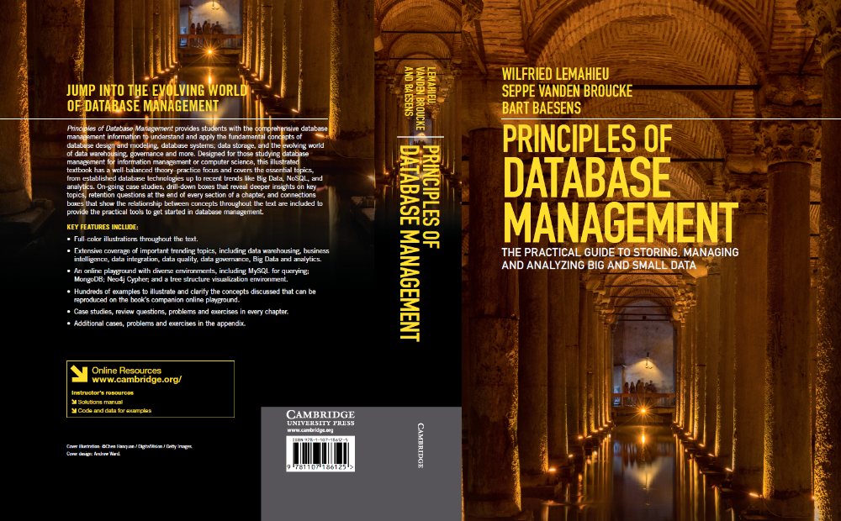
Data Distribution and Distributed Transaction Management
www.pdbmbook.com

Slide 2
Introduction
Distributed Systems and Distributed Databases
Architectural Implications of Distributed Databases
Fragmentation, Allocation and Replication
Transparency
Distributed Query Processing
Distributed Transaction Management and Concurrency Control
Eventual Consistency and BASE Transactions

Slide 3
Distributed Systems and Distributed Databases
Distributed computing system consists of several processing units (nodes) with a certain level of autonomy, which are interconnected by a network and which cooperatively perform complex tasks
By dividing and distributing a complex problem into smaller, more manageable units of work, the complexity becomes manageable
Distributed database systems distribute data and data retrieval functionality over multiple data sources and/or locations
Goal is to provide an integrated view of the distributed data and transparency

Slide 4
Distributed Systems and Distributed Databases
Distributed database environment
  deliberate choice
  merger or acquisition
  consecutive investments in different technologies
Distribution aspects
  performance
  local autonomy
  availability
  degree of transparency
  distributed query processing\transaction management\concurrency control and recovery

Slide 5
Architectural Implications of Distributed Databases
Shared memory architecture
  multiple interconnected processors that run the DBMS software share the same central storage and secondary storage
Shared disk architecture
  each processor has its own central storage but shares secondary storage with other processors (using e.g. a SAN or NAS)
Shared-nothing architecture
  each processor has its own central storage and hard disk units
  data sharing occurs through the processors communicating with one another over the network

Slide 6
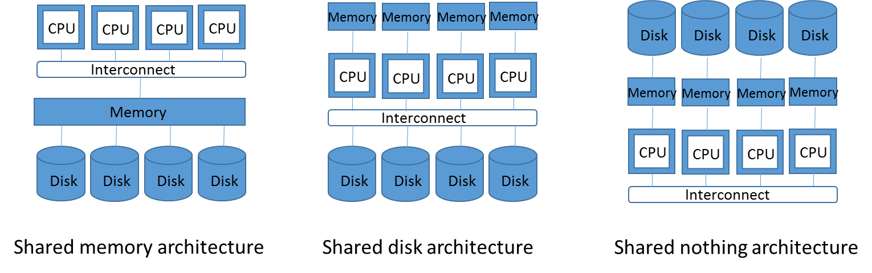
Architectural Implications of Distributed Databases

Slide 7
Architectural Implications of Distributed Databases
Scalability can be achieved in 2 ways
  capacity of nodes can be increased (vertical scalability)
  more nodes can be added (horizontal scalability)
Notes
  parallel databases
    focus on data distribution for performance
    intra-query versus inter-query parallelism
  federated databases
    nodes in a shared-nothing architecture each run an independent DBMS instance with horizontal data fragmentation

Slide 8
Fragmentation, Allocation and Replication
Fragmentation: partitioning of data into subsets (fragments) based on performance, local autonomy and availability
Vertical fragmentation
  fragment consists of subset of columns of data
  global view with JOIN query
  useful if only some of a tuple’s attributes are relevant to a certain node
Horizontal fragmentation (Sharding)
  fragment consists of rows that satisfy a query predicate
  global view with UNION query
  common in NoSQL databases
Mixed fragmentation
  combines horizontal and vertical fragmentation
  global view with JOIN + UNION query

Slide 9
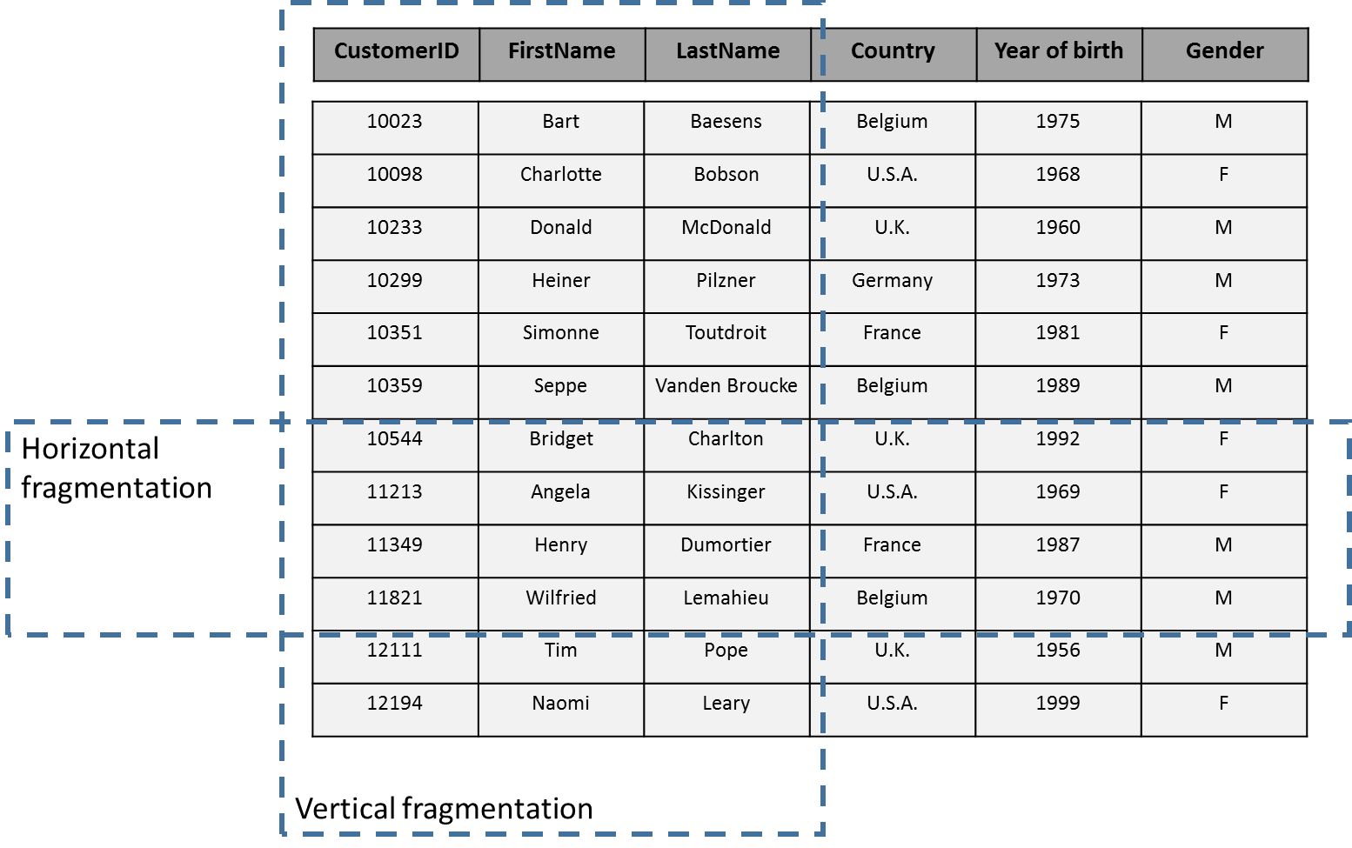
Fragmentation, Allocation and Replication

Slide 10
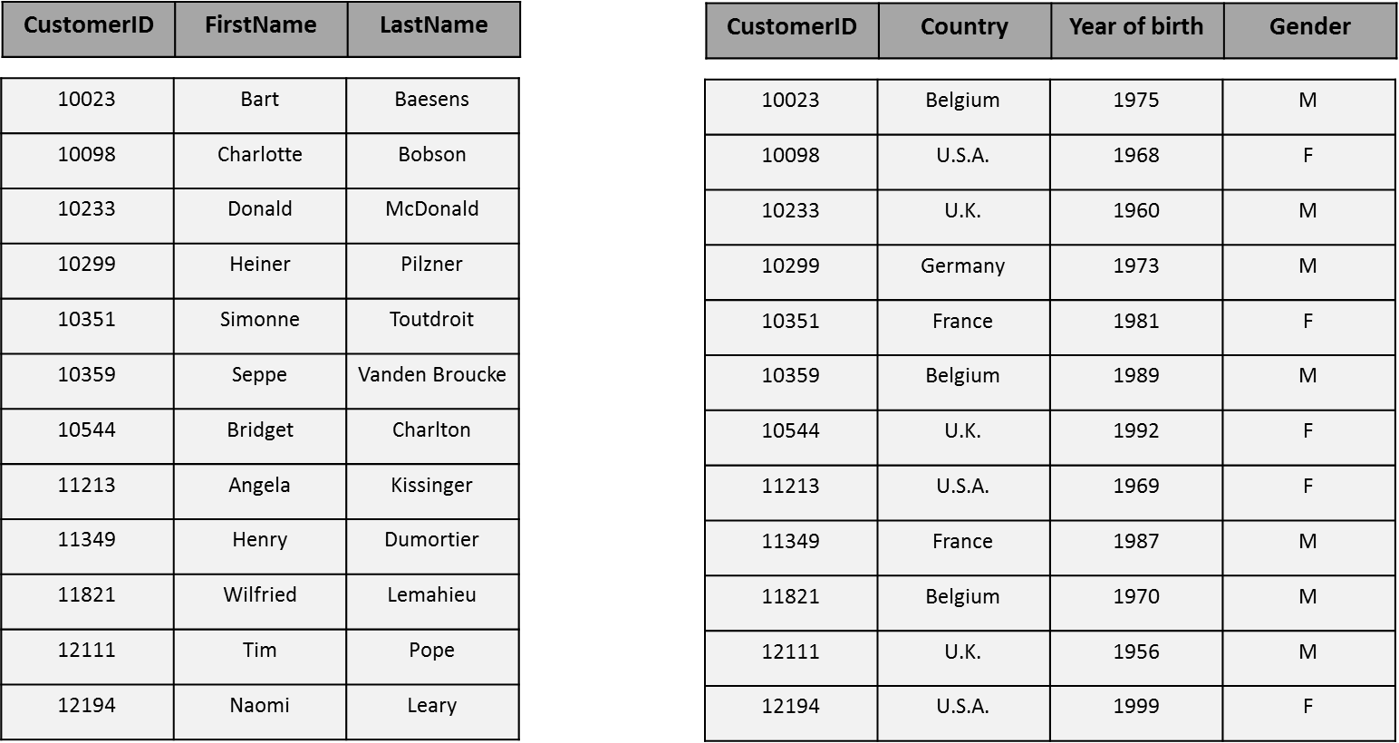
Fragmentation, Allocation and Replication

Slide 11
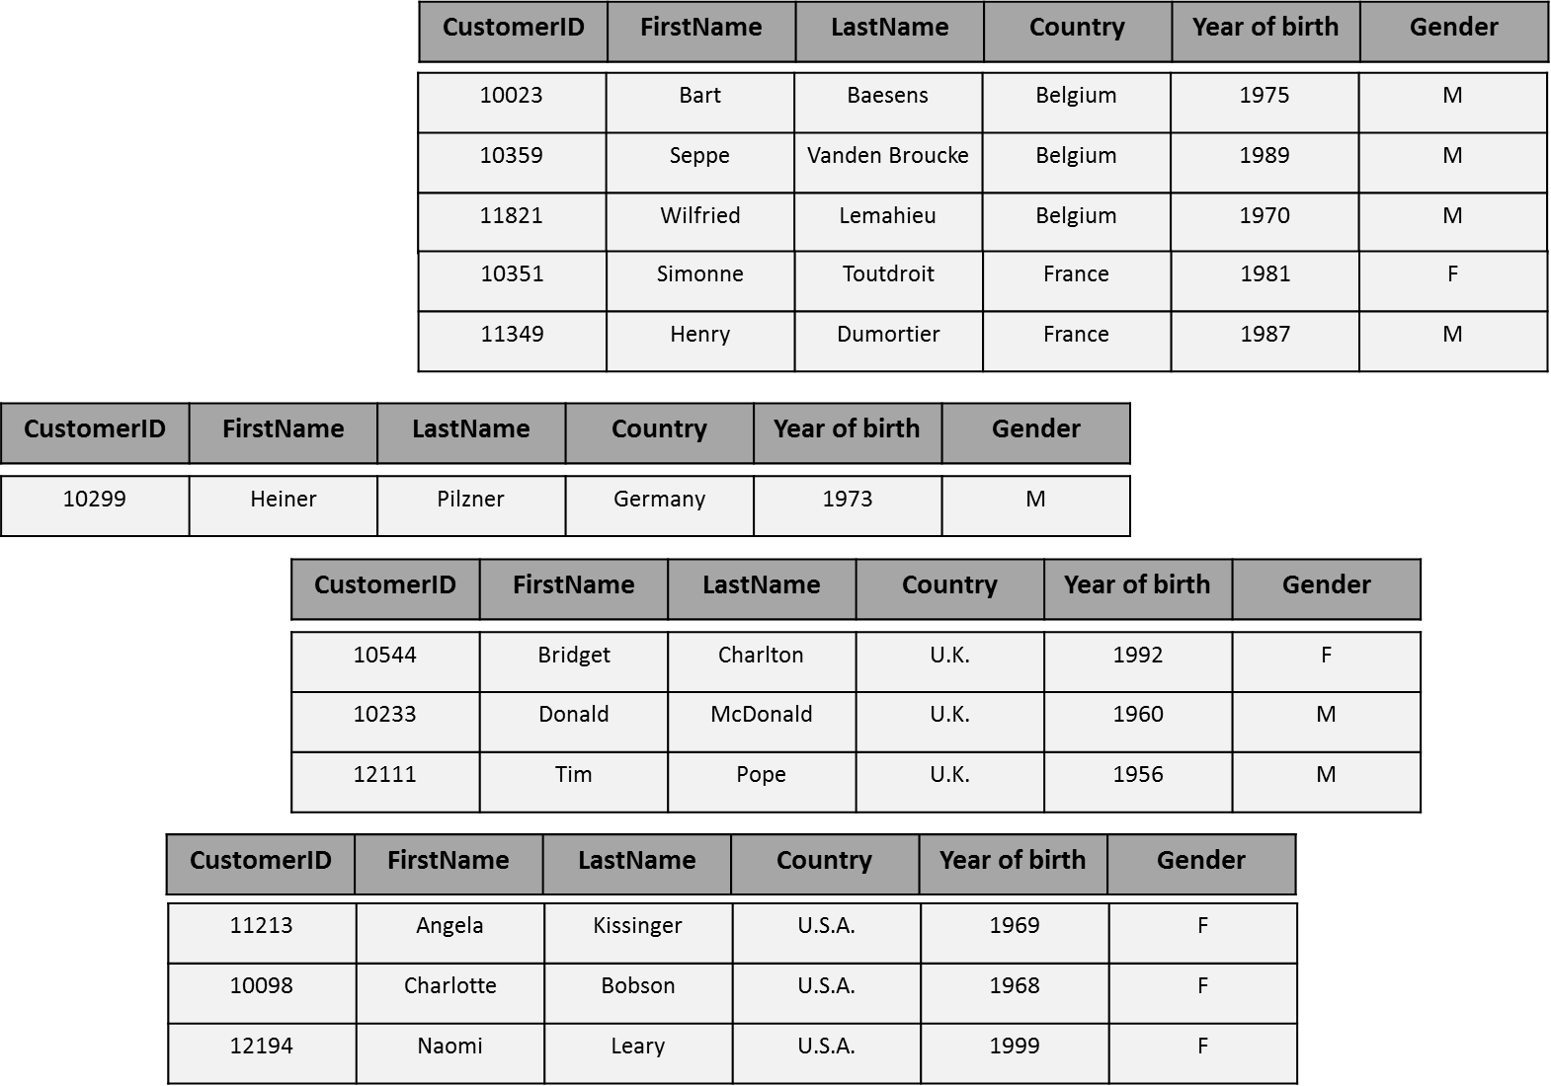
Fragmentation, Allocation and Replication

Slide 12
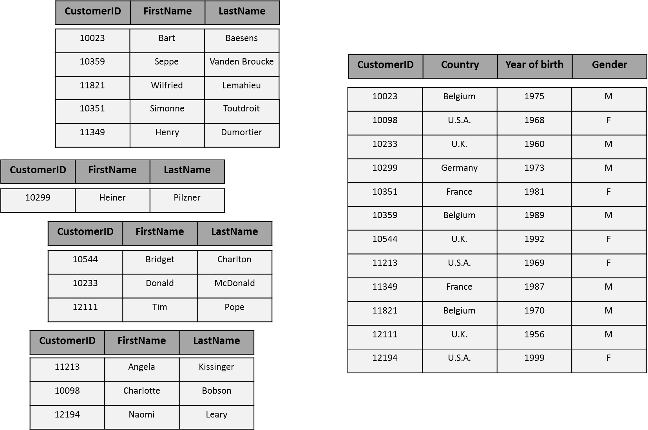
Fragmentation, Allocation and Replication

Slide 13
Fragmentation, Allocation and Replication
Derived fragmentation
  fragmentation criteria belong to another table
Data replication occurs when the fragments overlap, or if there are multiple identical fragments allocated to different nodes so as to ensure
  local autonomy
  performance and scalability
  reliability and availability
Note: replication induces additional overhead and complexity to keep replicas consistent!

Slide 14
Fragmentation, Allocation and Replication
Also metadata can be distributed and replicated
Local versus global catalog

Slide 15
Transparency
Transparency: application and users confronted with only a single logical database and are insulated from the complexities of the distribution
  extension to logical and physical data independence
Location transparency
  users don’t know where required data resides
Fragmentation transparency
  users can execute global queries, without being concerned with the fact that distributed fragments will be involved, and need to be combined

Slide 16
Transparency
Replication transparency
  different replicas will be kept consistent and updates to one replica will be propagated transparently to others
Access transparency
  distributed database can be accessed and queried uniformly, regardless of different database systems and APIs
Transaction transparency
  DBMS transparently performs distributed transactions as if they were transactions in a standalone system

Slide 17
Distributed Query Processing
Optimizer should not only consider the elements of a standalone setting but also properties of respective fragments, communication costs, and location of the data in the network
Also metadata may be distributed
Both global (across all nodes) and local (within a single node) query optimization are needed

Slide 18
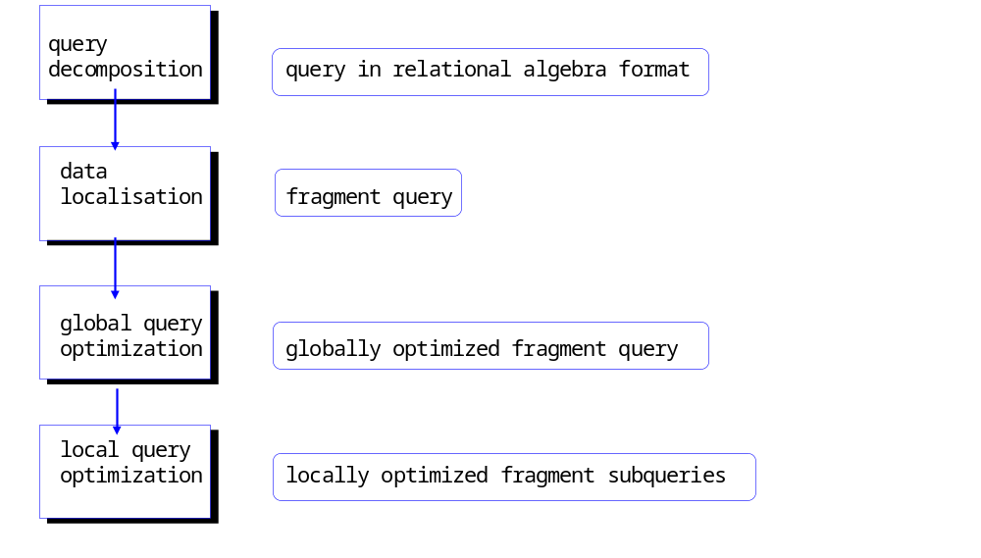
Distributed Query Processing

Slide 19
Distributed Query Processing
Decomposition
  query first analysed for correctness (syntax, etc.)
  query represented in relational algebra and transformed into canonical form
Data localization
  transformation of query into a fragment query
  database fragments and locations are identified
Global query optimization
  cost model is used to evaluate different global strategies
Local query optimization
  optimal strategy for local execution

Slide 20
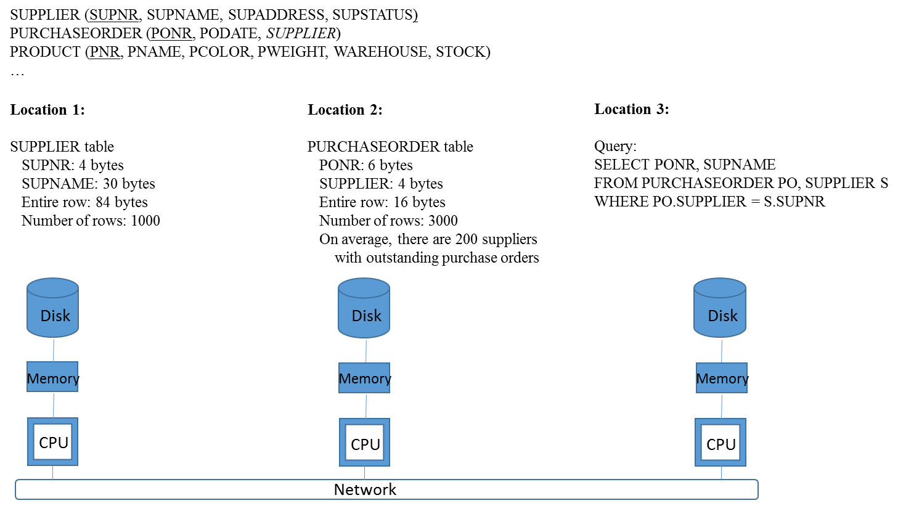
Distributed Query Processing

Slide 21
Distributed Query Processing
Strategy 1
  all tables are copied to location 3, which is also the location where all querying is performed
  data transport amounts to (1000 x 84) + (3000 x 16) bytes = 132,000 bytes
Strategy 2
  SUPPLIER table is copied to location 2, where it is joined with the PURCHASEORDER table
  query result is then sent to location 3
  data transport amounts to (1000 x 84) + (3000 x (6 + 30)) bytes = 192,000 bytes

Slide 22
Distributed Query Processing
Strategy 3
  PURCHASEORDER table is copied to location 1, where it is joined with the SUPPLIER table
  query result is sent to location 3
  data transport amounts to (3000 x 16) bytes + (3000 x (6 + 30)) bytes = 156.000 bytes

Slide 23
Distributed Query Processing
Strategy 4
  use semi-join technique
  in location 2, a projection operation is executed, to yield all numbers of suppliers associated with a purchase order (say around 200 supplier numbers)
  numbers are copied to location 1, where a join operation is executed to combine supplier numbers with names
  intermediate result is copied to location 2 for further processing
  final result is sent to location 3
  data transport amounts to only (200 x 4) + (200 x (4 + 30)) + (3000 x (6 + 30)) bytes = 115.600 bytes
  Lowest network traffic but higher processing cost!

Slide 24
Distributed Transaction Management and Concurrency Control
Tightly versus Loosely Coupled Setting
Primary Site and Primary Copy 2PL
Distributed 2PL
Two-Phase Commit Protocol (2PC)
Optimistic Concurrency and Loosely Coupled Systems
Compensation-Based Transaction Models

Slide 25
Tightly versus Loosely Coupled Setting
Global transaction coordinator versus local participants
Tightly coupled setting
  interdependence between participants and central control are substantial
  distributed transaction required to have ‘ACID’ properties
  typically paired with synchronous communication
Loosely coupled setting
  mobile devices, web services and programming models such as .NET
  interactions based on asynchronous messaging and locally replicated data
  cached local updates only synchronized periodically with global system
  often apply some form of optimistic concurrency

Slide 26
Primary Site and Primary Copy 2PL
Primary site 2PL
  centralized 2PL protocol in distributed environment
  single lock manager applies 2PL rules
  lock manager informs coordinator when locks can be granted
  participant that has completed processing will notify coordinator who, then instructs central lock manager to release locks
  biggest advantage is relative simplicity (no global deadlocks!)
  lock manager may become bottleneck + no location autonomy and limited reliability/availability

Slide 27
Primary Site and Primary Copy 2PL
Primary Copy 2PL
  lock managers implemented at different locations and maintain locking information pertaining to a predefined subset of the data
  requests for granting and releasing locks directed to the lock manager responsible for that subset
  impact of particular location going down will be less severe than with primary site 2PL

Slide 28
Distributed 2PL
Every site has its own lock manager, which manages all locking data pertaining to the fragments stored on that site
For global transactions that involve updates at n sites
  n locking requests
  n confirmations about whether the locks are granted or not
  n notifications of local operations having completed
  n requests to release the locks
Location autonomy is respected but deadlocks may occur

Slide 29
Distributed 2PL
If database has no replicated data, applying 2PL protocol guarantees serializability
  serializable global schedule is union of local serializable schedules
In case of replication, 2PL protocol must be extended

Slide 30
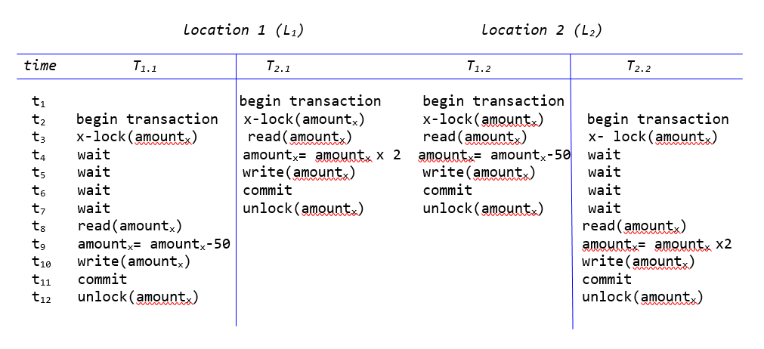
Distributed 2PL

Slide 31
Distributed 2PL
2PL can give rise to global deadlocks
  can not be detected by local lock managers
Deadlock detection in distributed 2PL requires the construction of a global wait-for graph
  schedule is only deadlock free if not only the local graphs, but also the global graph contains no cycles

Slide 32
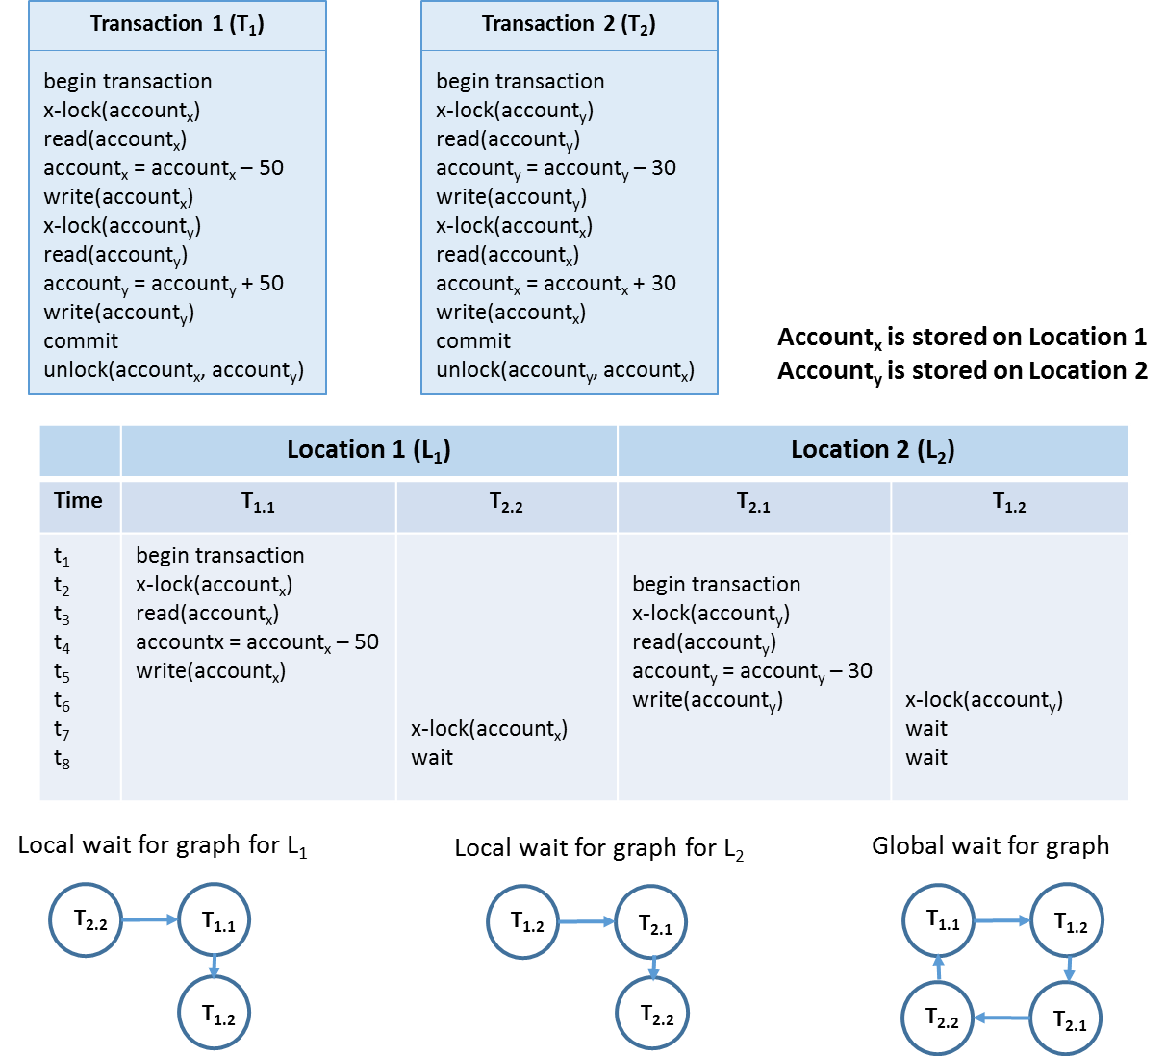
Distributed 2PL

Slide 33
Distributed 2PL
Example approach to detect global deadlocks
  central site maintains global wait-for graph
  all local lock managers periodically inform central site of changes in their local wait-for graphs
  if one or more cycles are detected, local lock managers will be informed accordingly and victim selection will determine which transaction(s) to abort and roll back

Slide 34
Two-Phase Commit Protocol (2PC)
Global transaction only attains ‘committed’ or ‘aborted’ state if all subtransactions have attained same state
Two-Phase Commit (2PC) Protocol supports transaction recovery in distributed environment
Global transaction completion involves 2 steps
  voting phase: all participants ‘vote’ about transaction outcome
  decision phase: transaction coordinator makes final decision about outcome

Slide 35
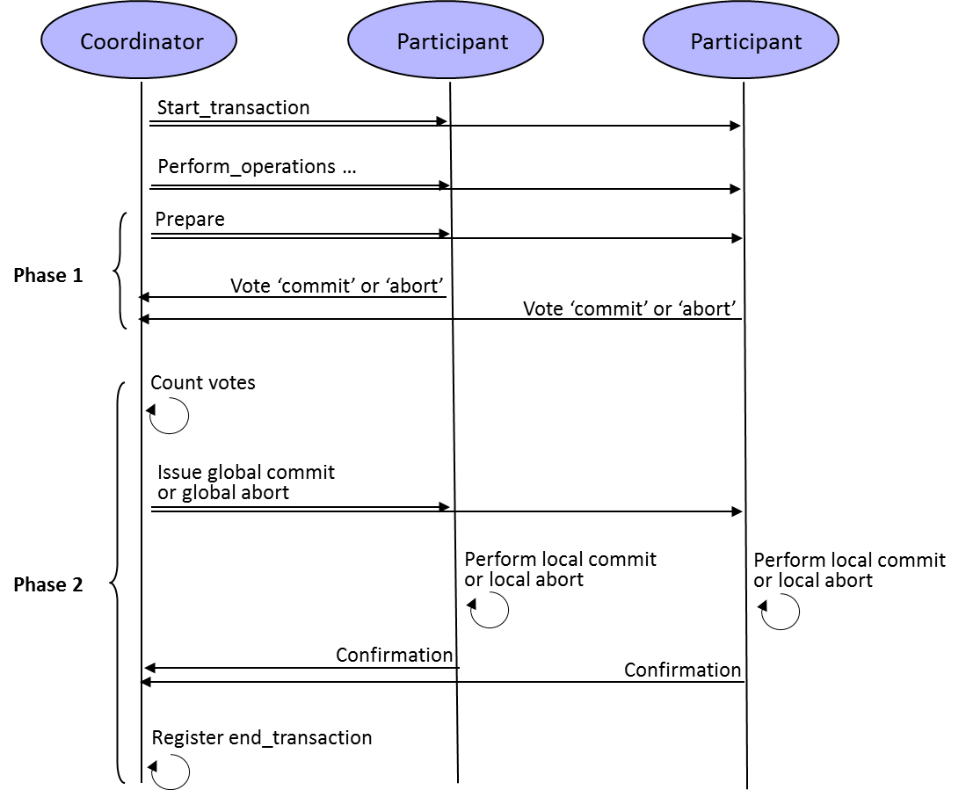
Two-Phase Commit Protocol (2PC)

Slide 36
Two-Phase Commit Protocol (2PC)
2PC protocol supplemented by
  termination protocol: describes how to react to a timeout
  recovery protocol: describes how faulty site should correctly resume operation after malfunction

Slide 37
Optimistic Concurrency and Loosely Coupled Systems
Optimistic protocols resolve conflict before transaction commit, typically with abort and rollback of conflicting transaction
  advantageous in distributed setting
Tightly coupled distributed systems often apply pessimistic concurrency protocol
  conflicting operations of other transactions postponed until locks released
  transactions are typically sufficiently short-lived so as not to hold any locks for longer periods

Slide 38
Optimistic Concurrency and Loosely Coupled Systems
Loosely coupled distributed systems often apply optimistic concurrency protocol
  locks only held during brief period when database connection is open, to exchange data between the database and, e.g. an ADO.NET DataSet
Example downside of optimistic concurrency
  suppose application A₁ reads data from database into a DataSet and then closes the database connection
  data in the disconnected dataset is updated locally
  new connection is opened to propagate to database
  no guarantee that data in the database was not altered by other application A₂!

Slide 39
Optimistic Concurrency and Loosely Coupled Systems
Detecting conflicting updates in optimistic concurrency setting
  Timestamps
    ‘timestamp’ column added to any table that is open to disconnected access indicating time of most recent update
    if A₁ retrieves rows and then disconnects, timestamp column is copied.
    when application attempts to propagate its updates to the database, the timestamp associated with updated row is compared to timestamp of corresponding row in database
    if both timestamps don’t match, the update by A₁ will be refused. Otherwise, updated row can be propagated safely and new timestamp value is stored.

Slide 40
Optimistic Concurrency and Loosely Coupled Systems
Detecting conflicting updates in an optimistic concurrency setting (contd.)
  store 2 versions of each row in the disconnected entity: ‘current’ version and ‘original’ version
    default in ADO.NET DataSet
    ‘original’ version contains values read from the database
    ‘current’ version contains values affected by local updates
    when updates are propagated to the database, for each locally updated row, the ‘original’ values are compared to values of the corresponding row in the database. If the values are identical, the row is updated, otherwise, update is rejected.

Slide 41
Optimistic Concurrency and Loosely Coupled Systems
UPDATE MYTABLE
SET column1 = @currentValue1,
column2 = @currentValue2,
column3 = @currentValue3
WHERE column1 = @originalValue1
AND column2 = @originalValue2
AND column3 = @originalValue3

Slide 42
Compensation-Based Transaction Models
Loosely coupled settings (e.g., web service environments) characterized by long running transactions
Example: travel agent web service
  pessimistic concurrency protocol not advised because locks might be held too long
  optimistic concurrency not advised because coordinated rollback across participants infeasible

Slide 43
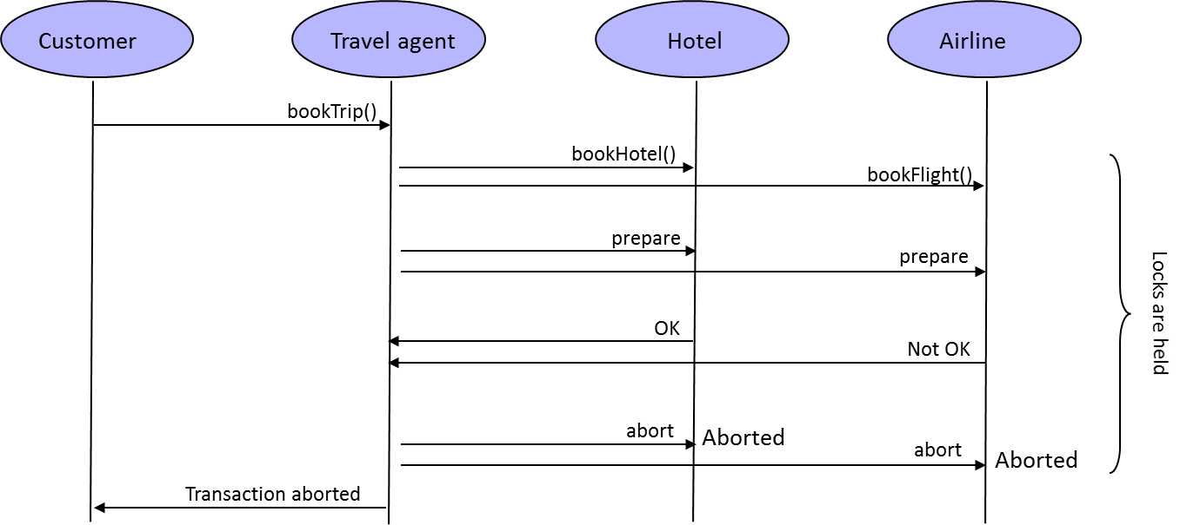
Compensation-Based Transaction Models

Slide 44
Compensation-Based Transaction Models
Compensation-based transaction model
  undo local effects of transaction if global long running transaction is unsuccessful
  abandons ‘atomicity’ property of long running transaction
  local subtransactions within single participant remain atomic and are committed asap, without waiting for global commit notification
  requires each transaction participant to define its transaction sensitive operations in pairs, with the second operation specifying a new local transaction that cancels out the effects of the first (‘compensation’)

Slide 45
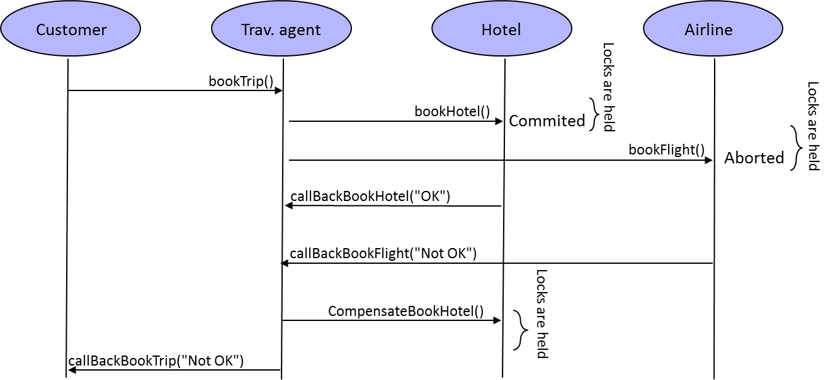
Compensation-Based Transaction Models

Slide 46
Compensation-Based Transaction Models
Compensation-based transaction model (contd.)
  requires for each transaction sensitive operation O_{i}, a compensating, hand-coded operation C_{i}
  if global transaction that invoked O_{i} is aborted, C_{i} will be invoked by transaction coordinator
  default transaction mechanism of, e.g. WS-BPEL, which define long running processes as orchestrations of individual web services
  does not guarantee transaction isolation

Slide 47
Compensation-Based Transaction Models
Closing thoughts
    pessimistic concurrency preferable if many concurrent updates to same data subsets are expected, and data consistency is important
    optimistic concurrency and/or compensation if concurrent access to same data subsets is limited or if read operations outnumber write operations
    trade-off between consistency and performance also pertinent to divide between RDBMSs and NoSQL DBMSs

Slide 48
Eventual Consistency and BASE Transactions
Horizontal Fragmentation and Consistent Hashing
CAP Theorem
BASE Transactions
Multi-Version Concurrency Control and Vector Clocks
Quorum-Based Consistency

Slide 49
Horizontal Fragmentation and Consistent Hashing
NoSQL databases apply horizontal fragmentation (sharding)
Shards allocated to different nodes in cluster with consistent hashing mechanism applied to data items’ key
Sharding usually entails replication and allows for parallel access
NoSQL DBMSs approach linear horizontal scalability
Sharding and replication yields high availability
Not possible with traditional RDBMS and ACID transactions

Slide 50
CAP Theorem
Distributed system has at most 2 of 3 properties
  Consistency: all nodes see same data, and same versions of these data, at the same time
  Availability: every request receives a response indicating success or failure
  Partition tolerance: system continues to work even if nodes go down or are added

Slide 51
CAP Theorem
Standalone system can provide both data consistency and availability with ACID transactions
Tightly coupled distributed DBMSs often sacrifice availability for consistency and partition tolerance
NoSQL DBMSs give up on consistency
  in big data settings, unavailability is costlier than (temporary) data inconsistency
  overhead of locking has severe impact on performance

Slide 52
CAP Theorem
Critical Notes
  performance degradation induced by overhead of mechanisms that enforce transactional consistency under normal operation, even in absence of network partitions is reason to abandon perpetual consistency
  availability and performance same concepts, with unavailability an extreme case of high latency and low performance
  real trade-off is between consistency and performance

Slide 53
BASE Transactions
NoSQL DBMSs do not give up on consistency
BASE transactions
  Basically Available: measures in place to guarantee availability under all circumstances, if necessary at cost of consistency
  Soft State: state may evolve, even without external input, due to asynchronous propagation of updates
  Eventually consistent: database will become consistent over time, but may not be consistent at any moment and especially not at transaction commit

Slide 54
BASE Transactions
Write operations performed on one or a few replicas of data item
Updates to other replicas propagated asynchronously in background
Read operations performed on one or few replicas
If read of multiple replicas gives inconsistent results
  DBMS uses timestamps (e.g., ‘last write wins’) and returns most recent version
  applications determines how conflicting replicas are reconciled

Slide 55
Multi-Version Concurrency Control and Vector Clocks
With BASE transactions, conflict resolution does not necessarily happen at moment of writing data but may be postponed until data is read
Rather than postponing write operation, new version of data item is created with updated value
DBMS may contain multiple inconsistent versions of a data item
  conflict resolution is postponed until data is retrieved

Slide 56
Multi-Version Concurrency Control and Vector Clocks
MVCC (Multi-Version Concurrency Control) protocol
  read operation returns one or more versions of data item; conflicts resolved by DBMS or application
  write operation creates new version of data item
  vector clocks used to discriminate between data item versions and to trace their origin
  obsolete versions of data item garbage collected
Vector clock consists of list of [node, counter] pairs
  node refers to node that handled write of that version
  counter denotes version number of writes by that node
Entirety of vector clocks associated with versions of data item represents lines of descendance of respective versions

Slide 57
Multi-Version Concurrency Control and Vector Clocks
Read operation retrieves all conflicting versions of data item, with the versions’ vector clocks
Write operation creates new version of a data item with corresponding vector clock
If all counters in a version’s vector clock are less-than-or-equal-to all counters in another version’s clock, then the first version is an ancestor of the second one and can safely be garbage collected
  otherwise, both versions represent conflicting versions and should be retained (may be reconciled later)

Slide 58
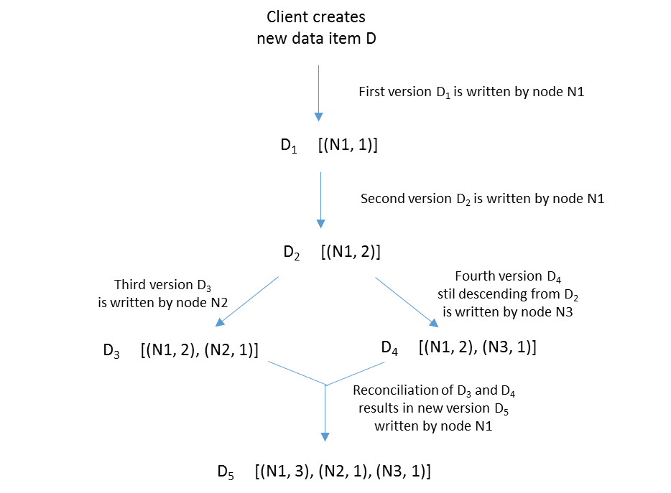
Multi-Version Concurrency Control and Vector Clocks

Slide 59
Quorum-Based Consistency
Administrator can position NoSQL DBMS on continuum between high availability and permanent consistency using quorum-based protocol
Quorum based protocols enforce consistency using 3 parameters N, R and W, with R ≤ N and W ≤ N
  N represents number of nodes to which data item is replicated
  R is minimum number of nodes that should respond before a read operation can be considered as completed
  W is the minimum number of nodes that should receive updated value before write operation can be considered as completed

Slide 60
Quorum-Based Consistency
By manipulating R and W, administrator can decide on trade-off between performance and consistency , but also on trade-off between read and write performance
Configuration with R + W > N is guaranteed to provide at least one up to date replica with each read operation
Configurations with R + W ≤ N have better read and/or write performance, but it cannot be guaranteed that the result set of each read operation will contain an up to date replica

Slide 61
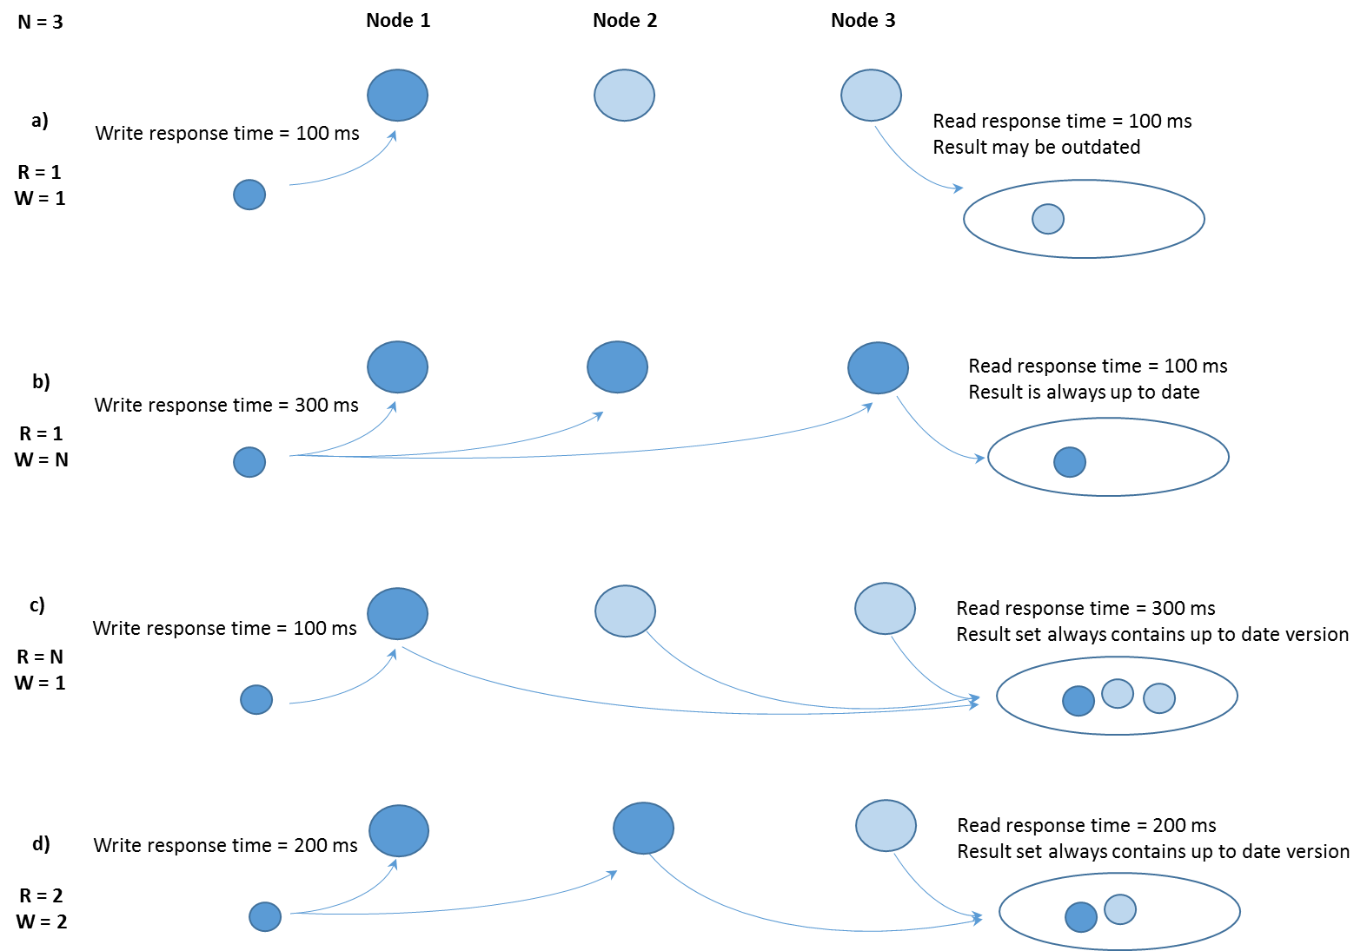
Quorum-Based Consistency

Slide 62
Conclusions
Distributed Systems and Distributed Databases
Architectural Implications of Distributed Databases
Fragmentation, Allocation and Replication
Transparency
Distributed Query Processing
Distributed Transaction Management and Concurrency Control
Eventual Consistency and BASE Transactions

Slide 63
More information?
www.pdbmbook.com

